Slide 1
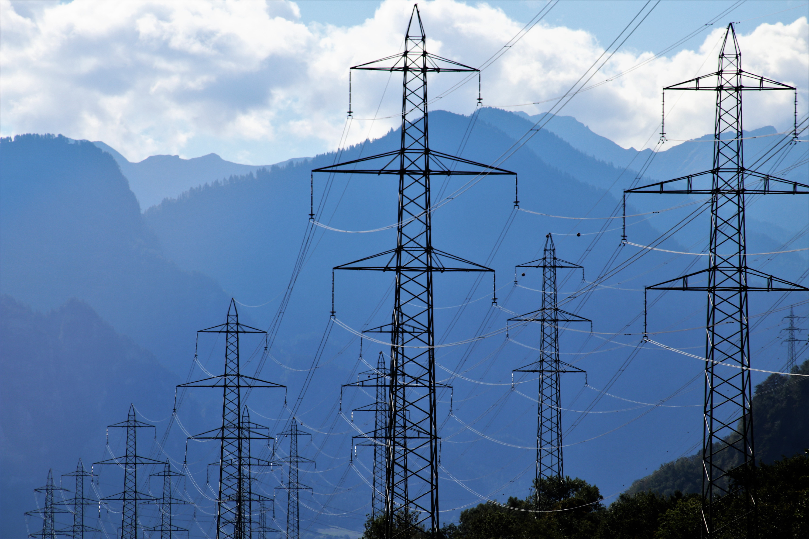

ENERGY
EFFICIENCY
REGION LEVEL MAPPING (U.S.)

Slide 2
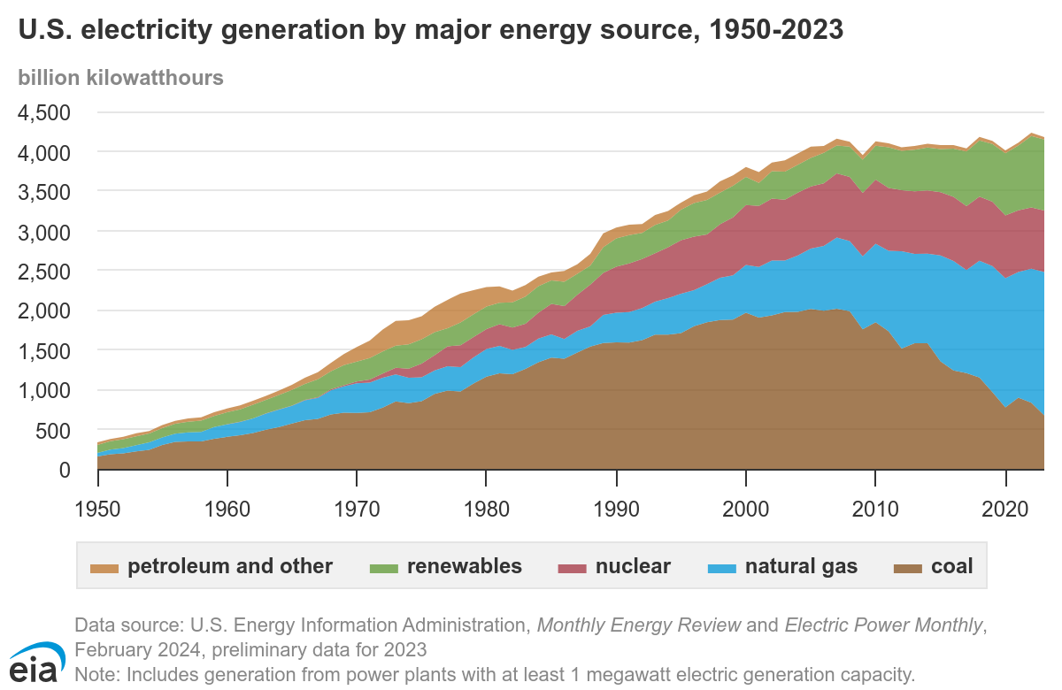
U.S. Energy Evolution
1970s: Age of Oil and Coal
1980s: The Rise of Natural Gas and Nuclear Power
1990s: Deregulation of Fossil Fuel and Emegance of Renewables
2000s: The Push for Clean Energy
2010s: The Clean Energy Revolution Accelerates
2020s: U.S. Energy Today
2030s: The U.S. Energy Vision

Slide 3

Challenges faced by U.S.
Huge Reliance on Imports
Dependence on Fossil Fuel
U.S. imports 3% of its electricity primarily from Canada and Mexico which accounts for approximately 70TWh
As of 2023, fossil fuel accounted for 60% (NG (40%), Coal (20%)) of total US energy needs leading to 74% of total carbon emissions

Slide 4
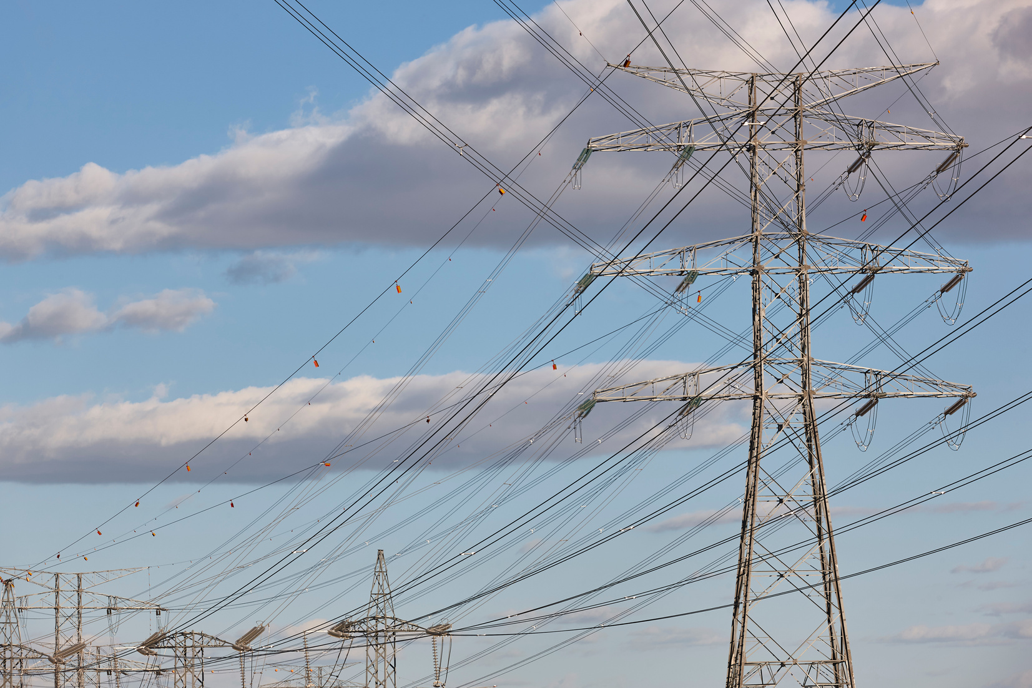
Challenges faced by U.S.
Transmission Bottlenecks
Climate Change and Environmental Impact
The U.S. faces challenges like transmission congestion and limited grid interconnections, raising electricity costs and limiting the flow of power from regions with abundant generation to high-demand areas.
The U.S. faces growing pressure to meet Paris Agreement climate goals, while fossil fuel plants like coal and nuclear are major sources in U.S.

Slide 5
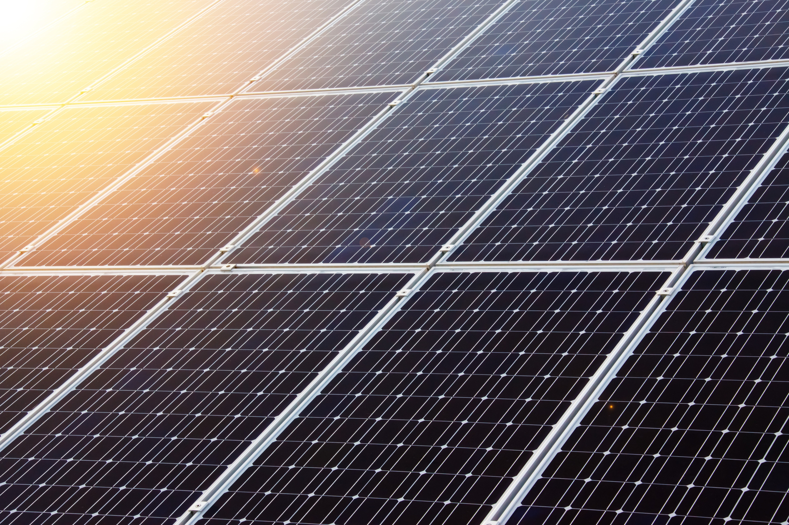
Business Context
01.
02.
03.
Rising Energy Consumption
Energy Independence
Affordable Clean Energy
(UN Sustainable Goal)

Slide 6


Our Product
Energy Efficiency Dashboard
Overview Dashboard: Insights on energy metrics like generation, consumption, efficiency, and seasonal trends.
Generation Dashboard: Analysis of electricity generation by source and region, with distinction between renewable and non-renewable, filtered by elevation.
Consumption Dashboard: Visualization of total consumption, revenue, average rates, and sector-wise energy distribution, highlighting state and sector variations.

Slide 7
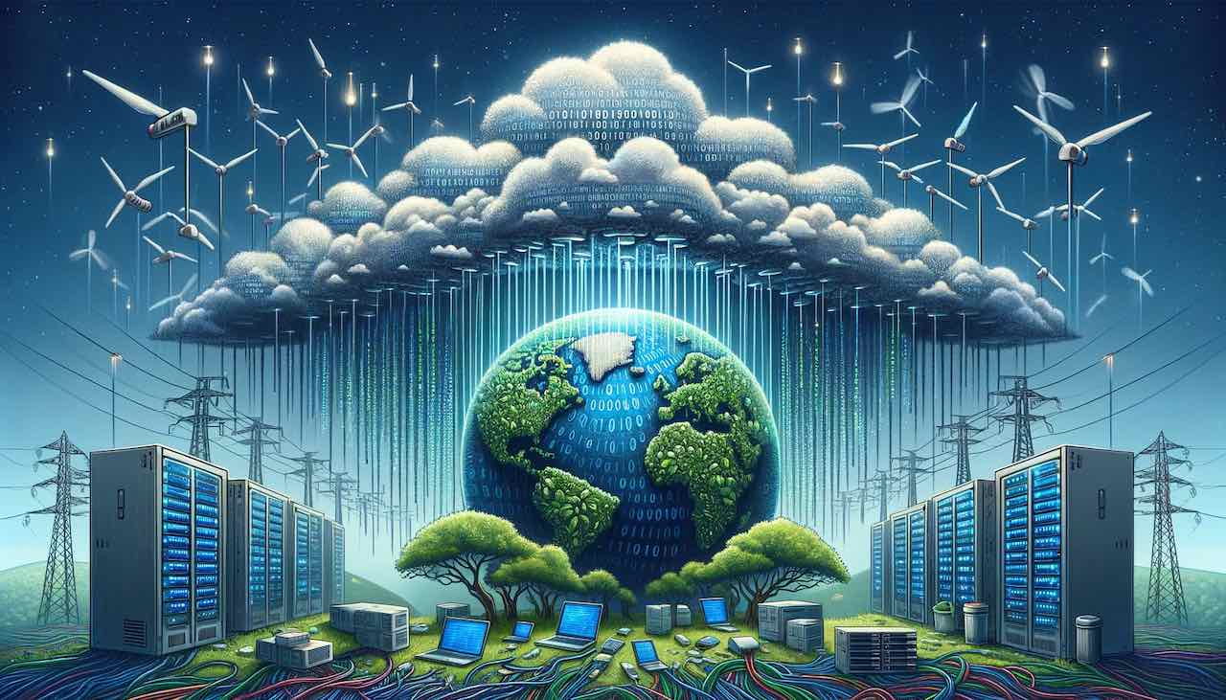
Product Benefit
Data-Driven Insights
Cost Insights
Performance Monitoring
Informed Decision Making
Environmental Impact

Slide 8

Project
Flow

Slide 9
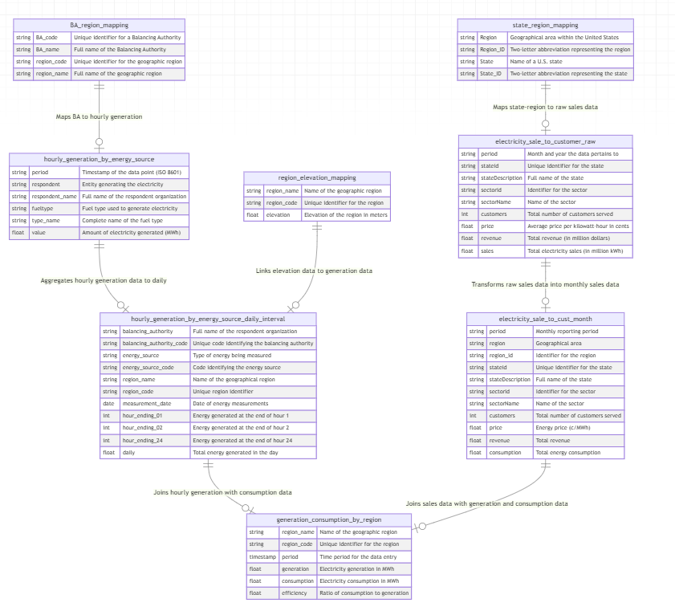
Data Model

Slide 10
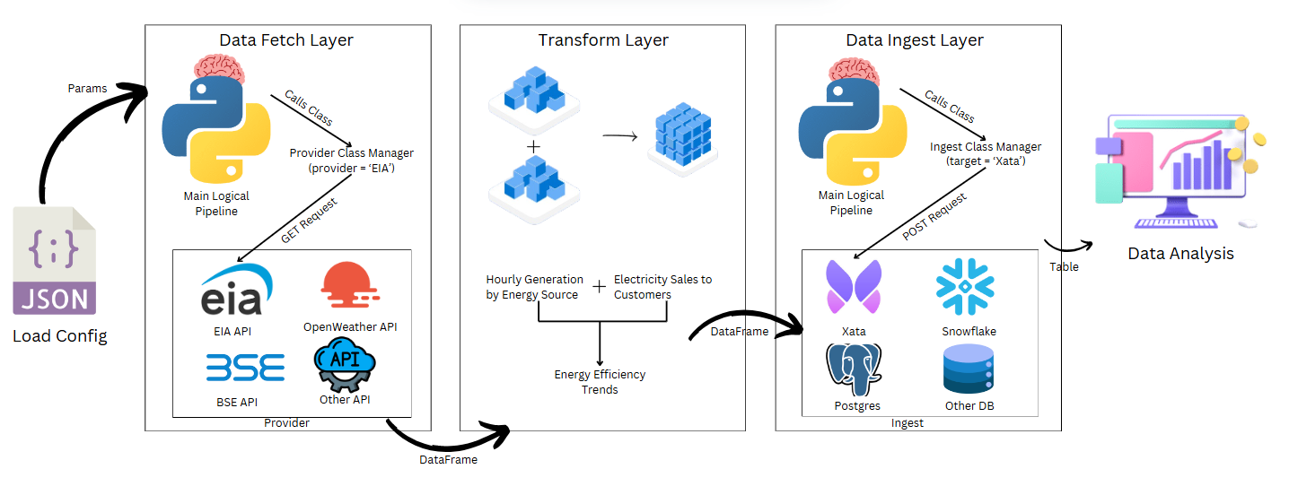
Technical Architecture

Slide 11
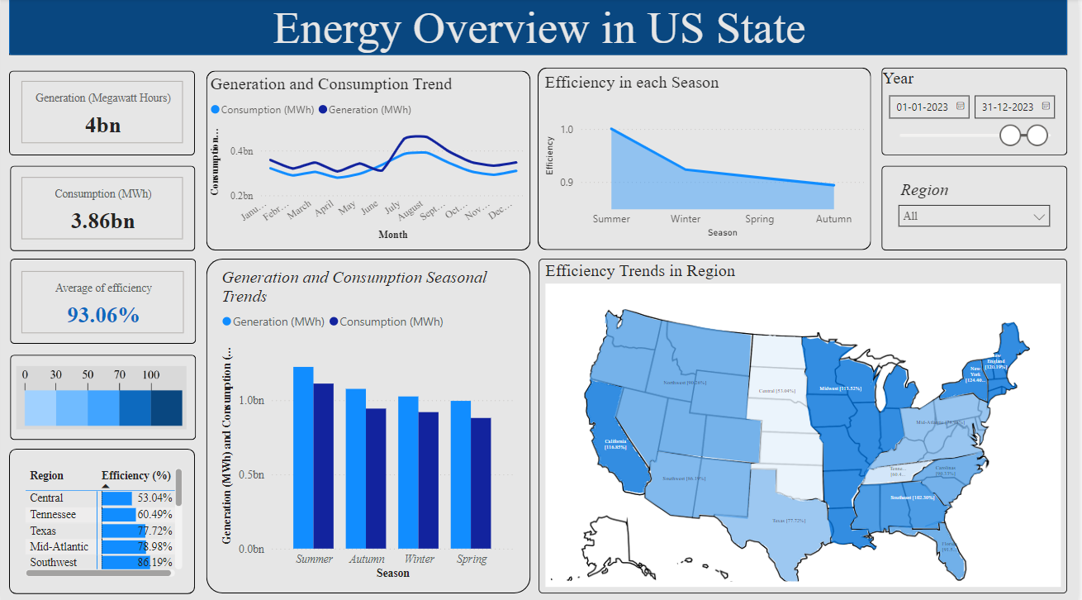

Slide 12
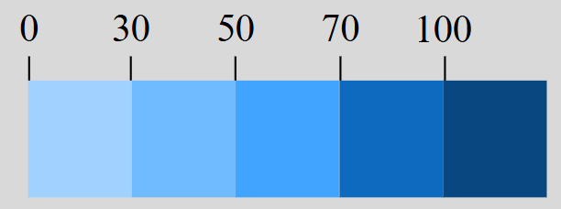
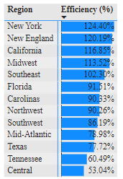
U.S. Energy Efficiency
Energy Efficiency Scale
Efficiency = Total Consumption / Total Generation
New York (124%): Dense population and high demand outstrip local generation; renewables still expanding, so imports fill gaps.
New England (120%): High winter heating demand and gas supply limits lead to frequent imports; older infrastructure restricts local capacity.
California (116%): Extreme cooling demand and intermittent renewables create shortages, with wildfire-related limits on transmission increasing imports.
Midwest (113%): Industrial and winter heating demands exceed local supply, with wind intermittency adding to import needs.
Southwest (102%): Intense summer cooling and rapid growth outpace generation; solar gaps after sunset require imports.

Slide 13
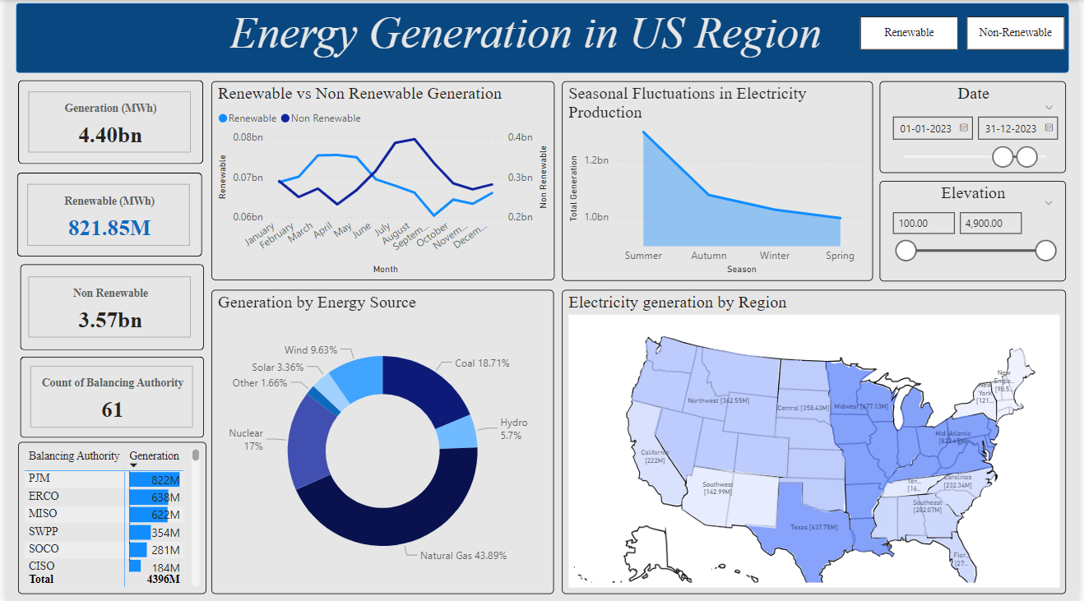

Slide 14
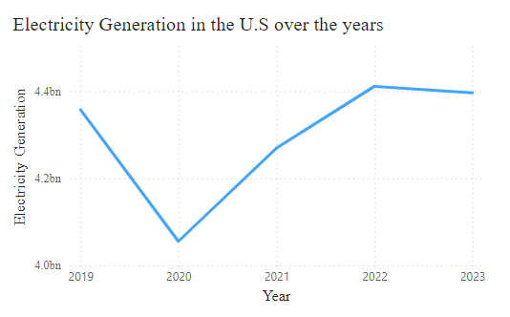
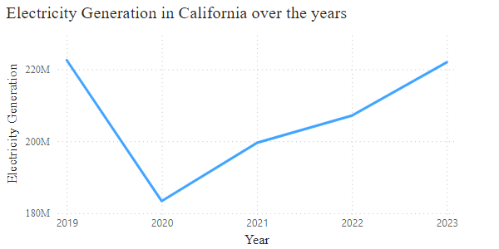
US Energy Generation Insights
As of 2023, the United States has the second-largest electricity sector in the world, following China, generating 4.4 billion MWh of energy, which accounts for approximately 1.8% of its GDP.
The sudden decrease in energy production from 2019 to 2020, around 5-6%, was largely attributed to the COVID-19 lockdown.
In 2023, California was the second-largest electricity consumer in the United States.
California imported more electricity than any other state.
Approximately 30% of California's electricity came from out-of-state sources.
The majority of these electricity imports came from the Southwest and Northwest regions.

Slide 15
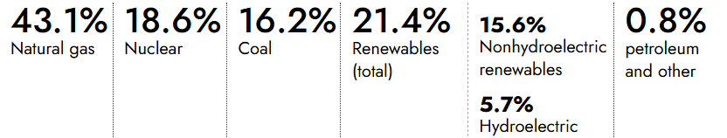
U.S. Electricity Generation by Source
The top three regions contributing the most to renewable energy generation in the United States are the Northwest, California, and the Texas region.
Northwest: This region generates approximately 50% of its energy from renewable sources, with more than 65% coming from hydroelectric power and around 25% from wind energy.
California: California produces about 45% of its energy from renewables, with the majority of this coming from solar power. By 2045, California aims to achieve 100% renewable energy generation.
In 2023, about 60% of U.S. utility-scale electricity generation was produced from fossil fuels (coal, natural gas, and petroleum), about 19% was from nuclear energy, and about 21% was from renewable energy sources.

Slide 16
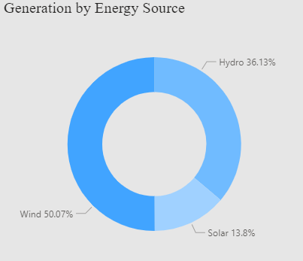
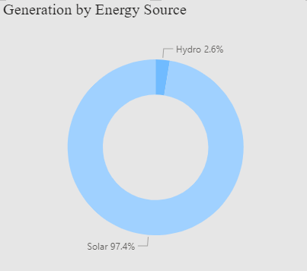
U.S. Electricity Generation through Renewables
U.S. generates 21% of total electricity from renewable sources (2023).
Wind accounts for 50% of U.S. renewable electricity generation (410M MWh).
Northwest region: Wind contributes 28% of total electricity.
Texas: Wind provides 77% of state’s renewable energy.
Solar electricity generation is higher at lower elevations.
Hydropower generation is more significant at higher elevations.
California is the leading state in solar energy generation, producing about 20% of its total electricity from solar power.

Slide 17
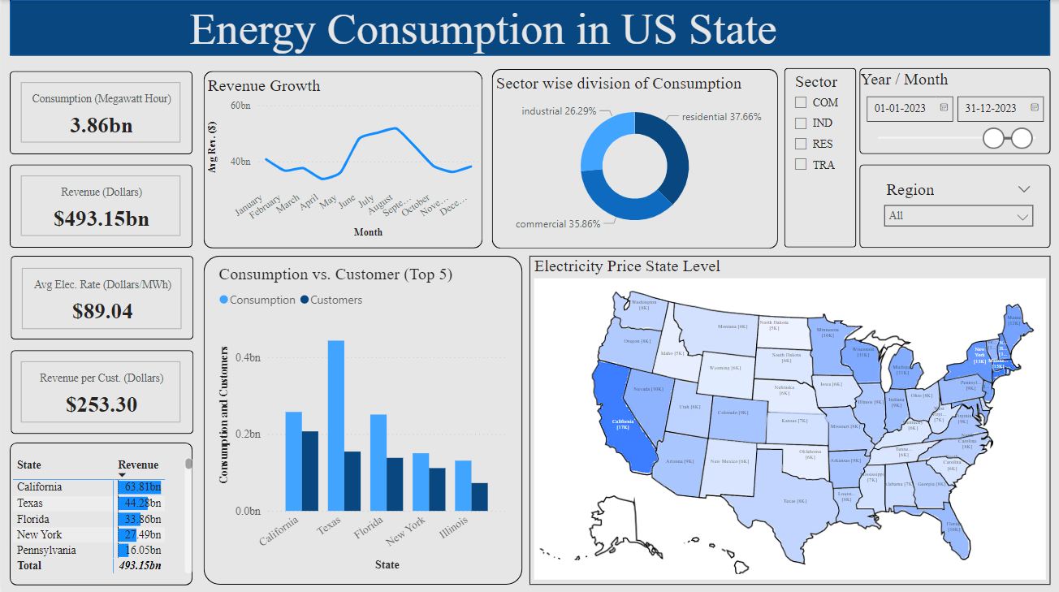

Slide 18
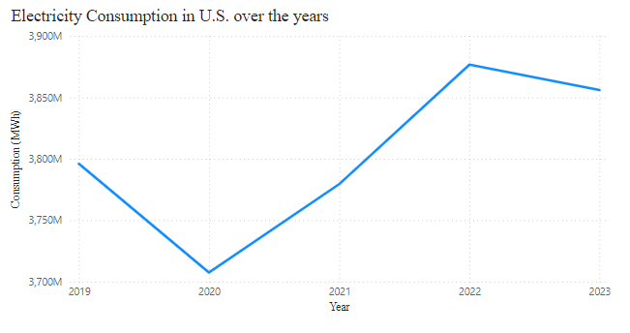
U.S. Electricity Consumption trends
With most people working from home due to the increasing spread of COVID-19 and overall consumption declining, the only notable increase in demand came from residential usage.

Slide 19
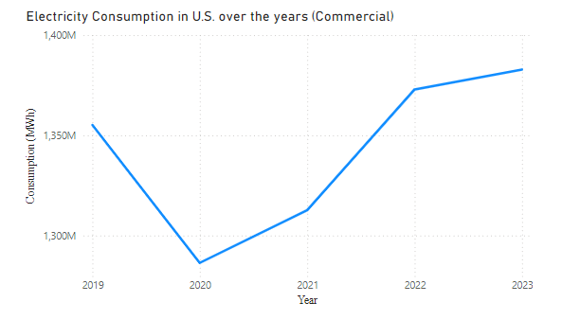
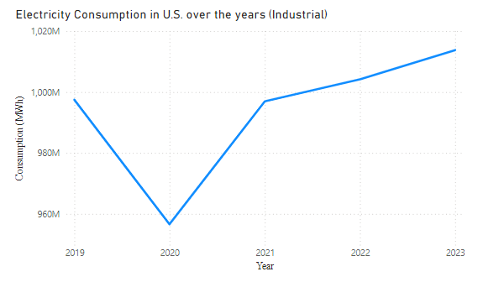
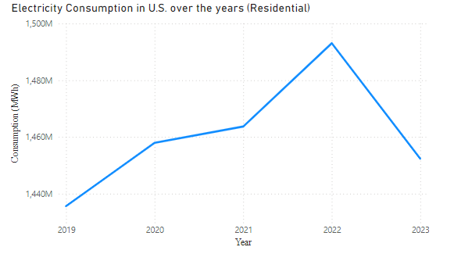
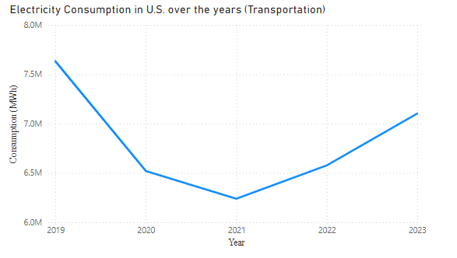
U.S. Electricity Consumption by Sector

Slide 20

Business Value
Our product empowers users to pinpoint the potential for renewable energy in diverse regions, facilitating sustainable energy solutions that significantly cut operational costs and unlock new revenue streams. By aligning with California’s goal of 100% renewable energy by 2045, we enhance our competitive advantage while ensuring regulatory compliance, substantial cost savings, and a stronger brand reputation. Additionally, this initiative positions us as a leader in the rapidly growing green energy market, offering scalability and attracting sustainability-focused investors.

Slide 21
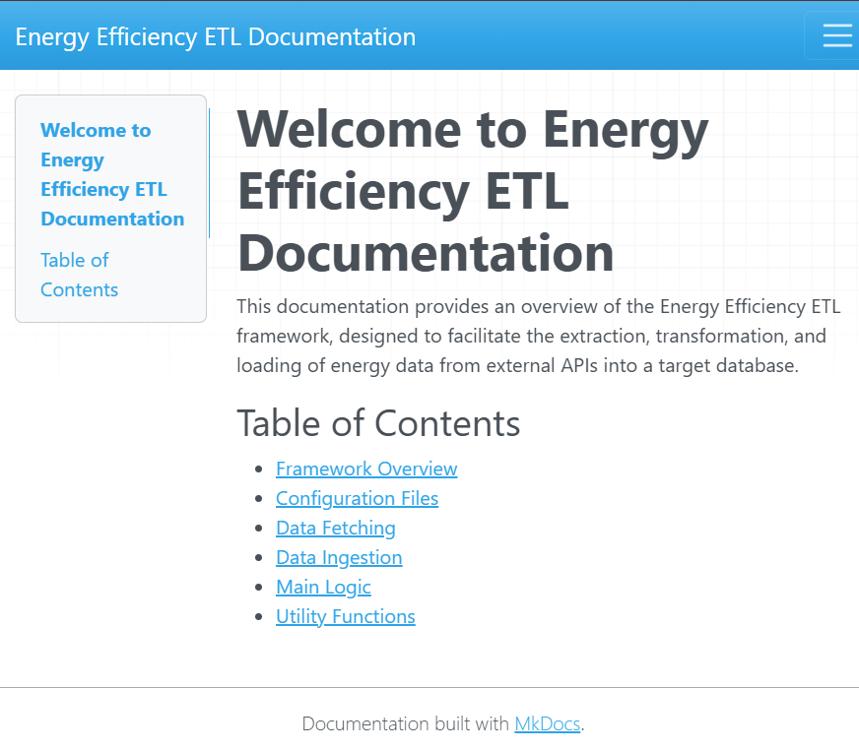
Outside the Scope
Documentation and Blogs using mkdocs and hosted it on GitHub Pages
The Documentation Includes:
Framework
Config Layer
Fetch Layer
Ingest Layer
Main Logic
Data Model
Blogs
How Electricity is Delivered to Customers
Wind and Solar to Lead Growth of U.S. Power Generation
U.S. Transition from a Net Importer to Net Exporter
Breaking Down Energy Consumption: A Sector-Wise Analysis of the U.S.
Dashboard
Overview
Generation
Consumption

Slide 22

Future
Scope
Forecasting
Demand Prediction
Predictive models to forecast future energy consumption, helping utilities anticipate and prepare for peak demand periods.
Analyzing factors like weather and usage patterns to predict short-term and long-term energy demand, aiding in proactive resource management.

Slide 23

Learning
ETL
Power BI
Xata (Postgres) Database
Python Framework
Factory Pattern
ABCs and Protocols in Python
Documentation using Mkdocs
Makefile
Research
Pre-Commit in GitHub
Hosting on GitHub pages
Content Creation
Logging
Teamwork
Communication

Slide 24
References
Slide 13 : California gov, EIA
Slide 14 : EIA
Slide 15 : Wikipedia, Wikipedia
Slide 17: EIA
Slide 18: Slide 11

Slide 25
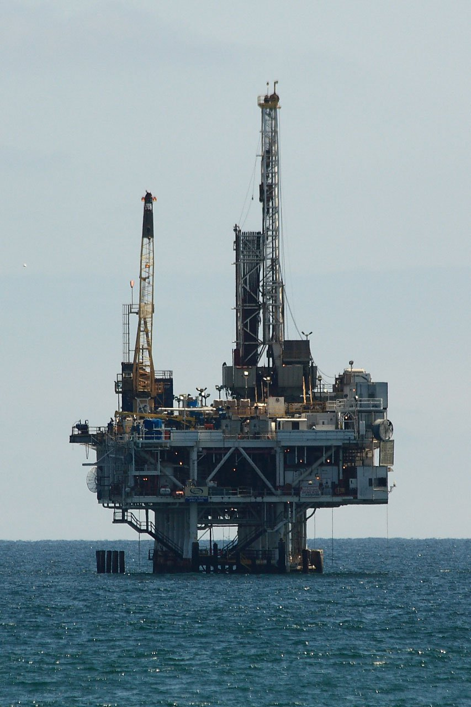
Thank You!

